Slide 1
Walmart Sales Predictions
By Rija Voloder

Slide 2

Problem and Stakeholders
Causes of high/low sales?
Timing/Holiday?
Economic state?
The goal is to give the company Walmart proactive suggestions to maximize sales and aid in demand forecasting.

Slide 3

Data
The data give included;
Timing
Holiday
CPI
Unemployment Rate
Store
Fuel Price
Temperature
Weekly Sales (target)

Slide 4
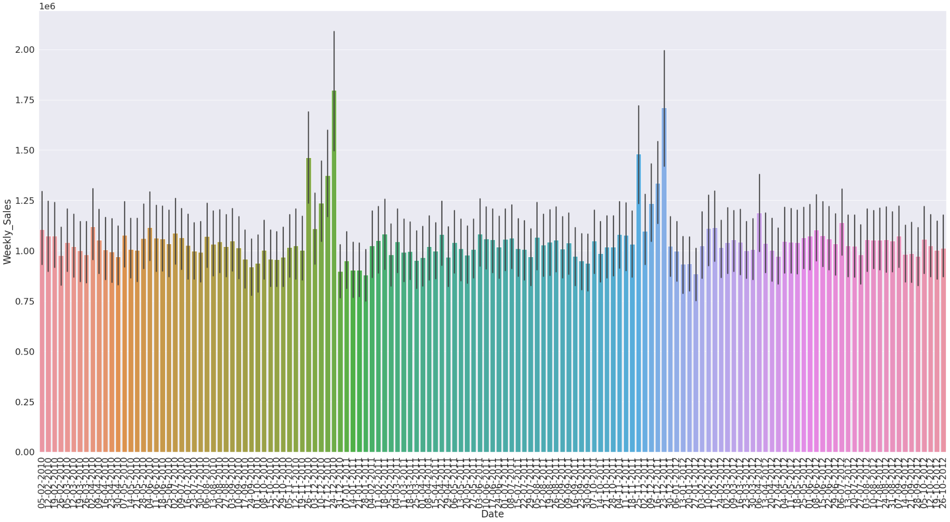

Slide 5
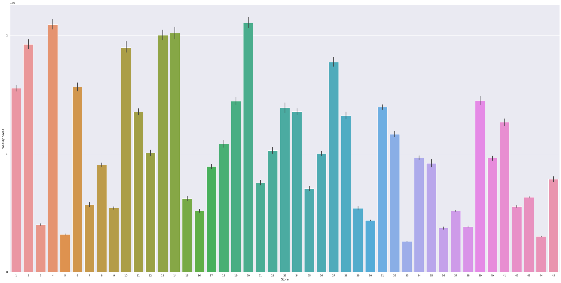

Slide 6
The Model
Strengths:
Explain 94% Variance
Predictions with around $25000 error
Weaknesses:
General Predictions (no individual products)
General Demand Forecasting

Slide 7

Recommendations
Stores 5, 33, 38, 44?
Higher Demand Forecasting Holiday Season
Special Deals After Christmas
Lower Income Areas
Case Study: Stores 2, 4, 13, 14, 20

